Slide 1
Bilingual Education:
Dual Language Programs as a Pathway to High Achievement

Slide 2
Dual Language:
Dual language refers to an instructional program that provides literacy and content instruction to all students through two languages and that promotes bilingualism and biliteracy, grade-level academic achievement, and multicultural competence for all students.

Slide 3
Two-Way Bilingual Classroom
Primary
English
Speakers
Primary Spanish
Speakers
Students Learn From Each Other
50%
CLASSROOM
50%
CLASSROOM
Bilingual & Biliterate Teachers

Slide 4
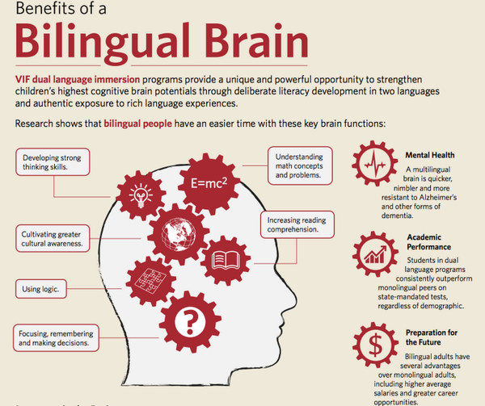
BENEFITS OF BILINGUALISM

Slide 5
High Achievement Through
Bilingual Education

Slide 6
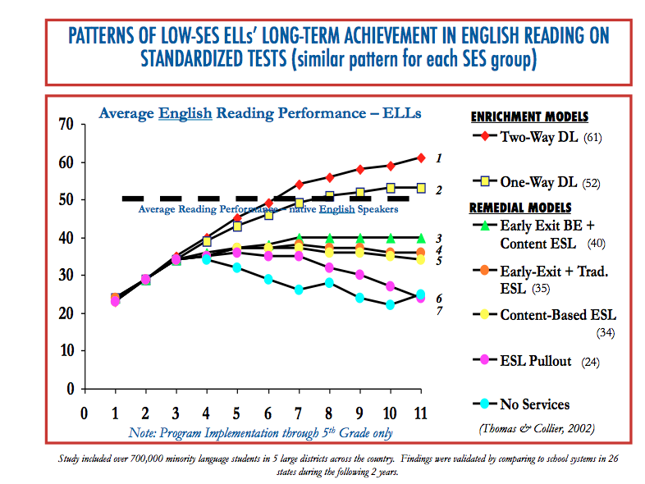

Slide 7
Since students in dual language programs are learning in two languages, their literacy trajectory at 3rd grade is slightly slower in developing than peers in English-only instruction. However, in 5th grade and beyond, learners in dual language programs outperform their peers on academic assessments in English (Escamilla et al., 2013; Genesee, Lindholm-Leary, Saunders, & Christian, 2006; Swenson & WatzingerTharp, 2012; Thomas & Collier, 2002).
Key Point:

Slide 8
OSPI Menu of Best Practices Highlights: English/Language Arts
When English Learners become literate in both their native language and English, they outperform peers in English-only instruction on standardized tests in English.
Implementing a two-way dual language core instruction program builds upon the bilingual assets of English Learners.
It is recommended to hire certificated staff with an EL or Bilingual Education endorsement to design and provide language instruction for English Learners. Whenever possible, hire biliterate teachers who are qualified to provide instruction in the student’s native language and English.

Slide 9
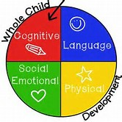
Bilingual Education Social/Emotional Benefits
School Culture of Respect and Acceptance
Pride in Native Culture and Language
Sense of Belonging for All Students
Multicultural/Global Perspective
Strengths-Based Approach to Learning

Slide 10
Woodland Public Schools: Key Considerations
Curriculum
Support Partners
Current Adopted Curricula in Spanish
Professional Learning for Educators
OSPI
Washington State University-Vancouver
Evergreen Public Schools
WABE (Washington Association of Bilingual Education)
Hiring
Early Recruitment
Multi-Year Plan for Program Progression
Community Engagement
Education Regarding Benefits
Input in Program Criteria

Slide 11
Woodland Public Schools, in partnership with families and the community, will create a PreK-12 system that serves and supports ALL children and ensures that EACH child has FULL access to, is engaged in, and obtains an excellent education that prepares them for responsible citizenship and a future of adaptability and success in life and their chosen endeavors.
Woodland Public Schools
Vision

Slide 12
Equity Opportunity High Achievement Educational Excellence
Dual Language Programs:

